Slide 1
Од функције
до
графика;
испитати особине
и скицирати график!

Slide 2
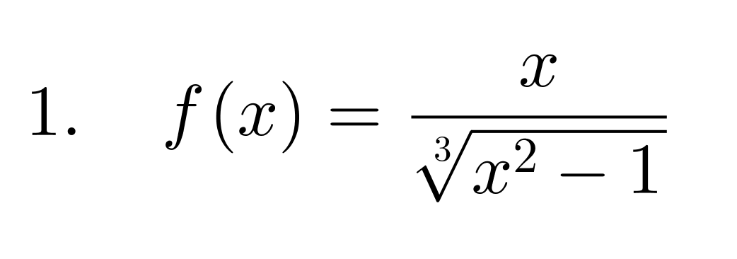

Slide 3
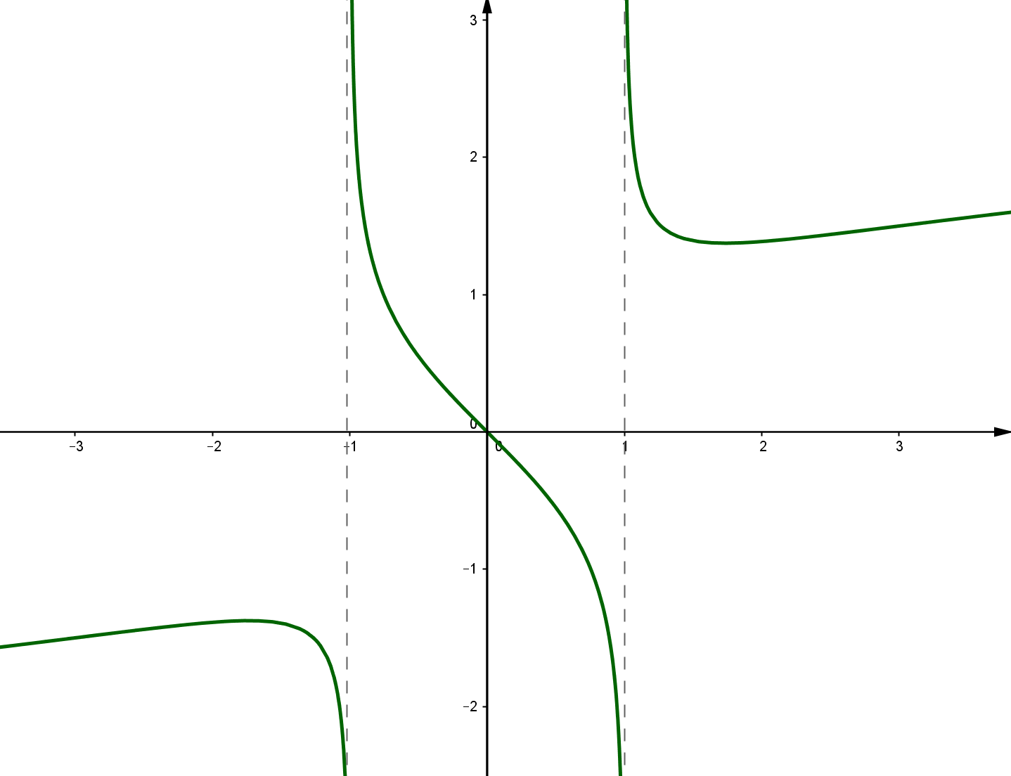

Slide 4
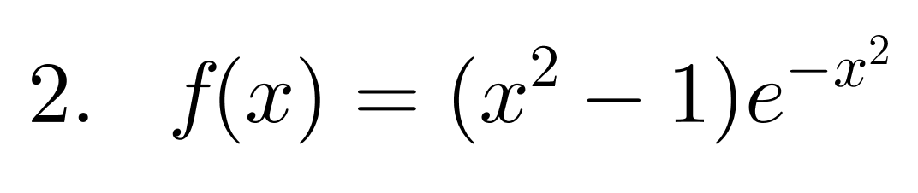

Slide 5
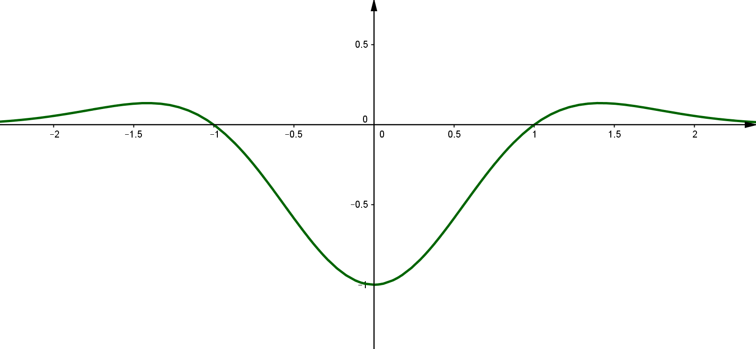

Slide 6
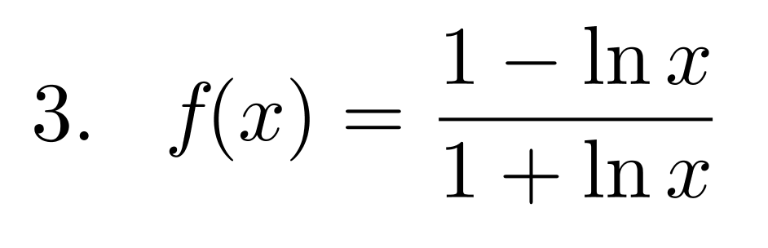

Slide 7
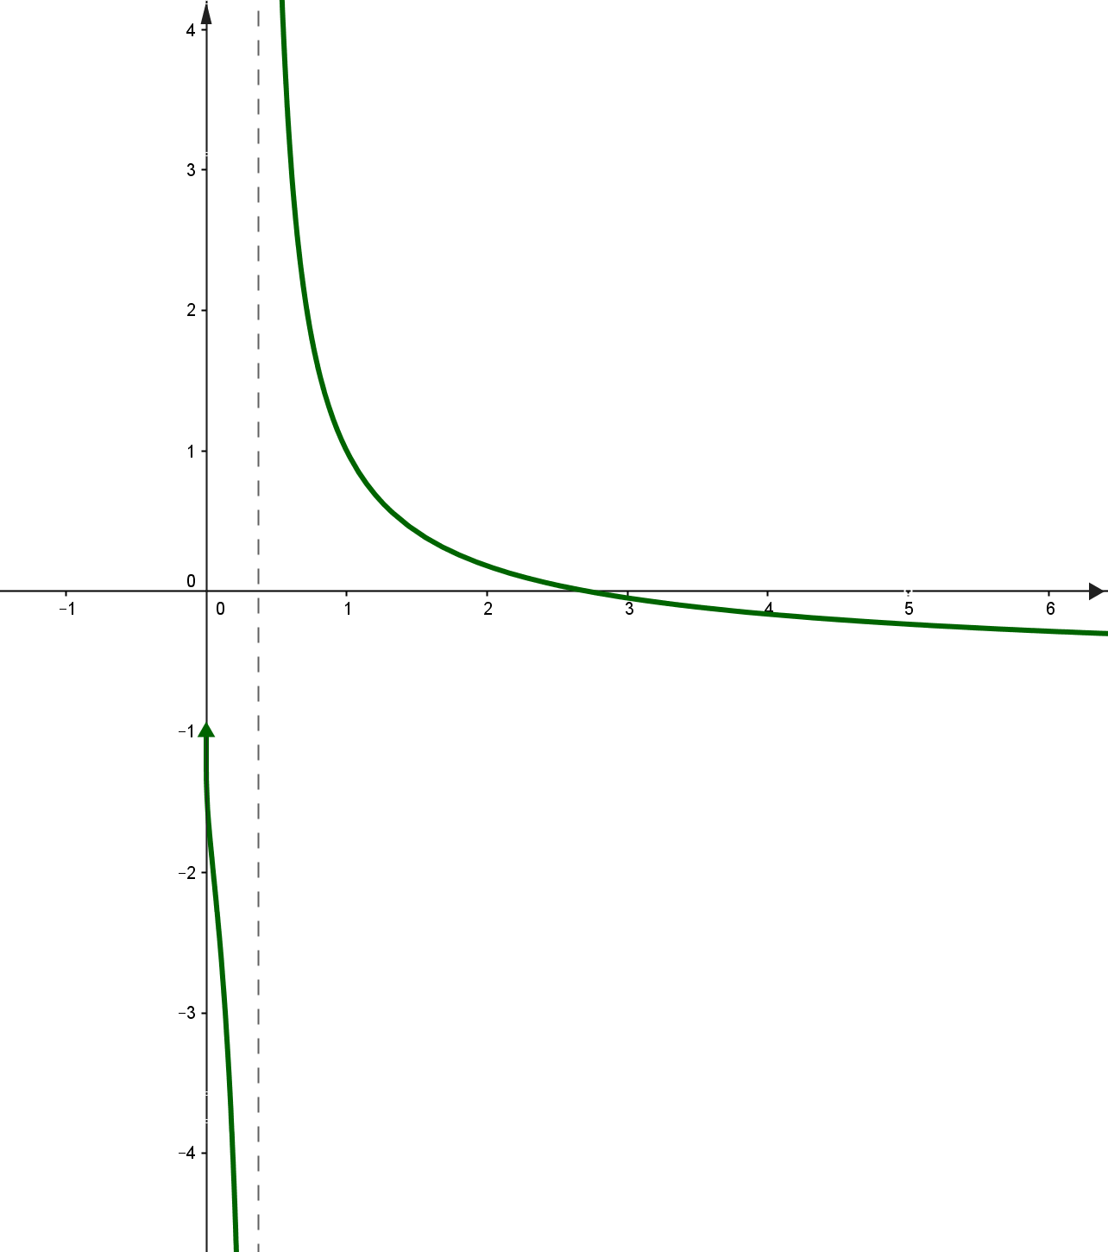

Slide 8
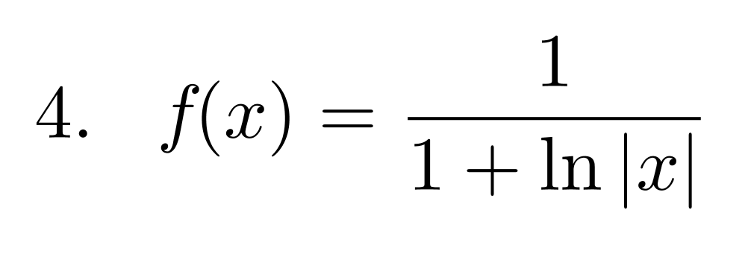

Slide 9
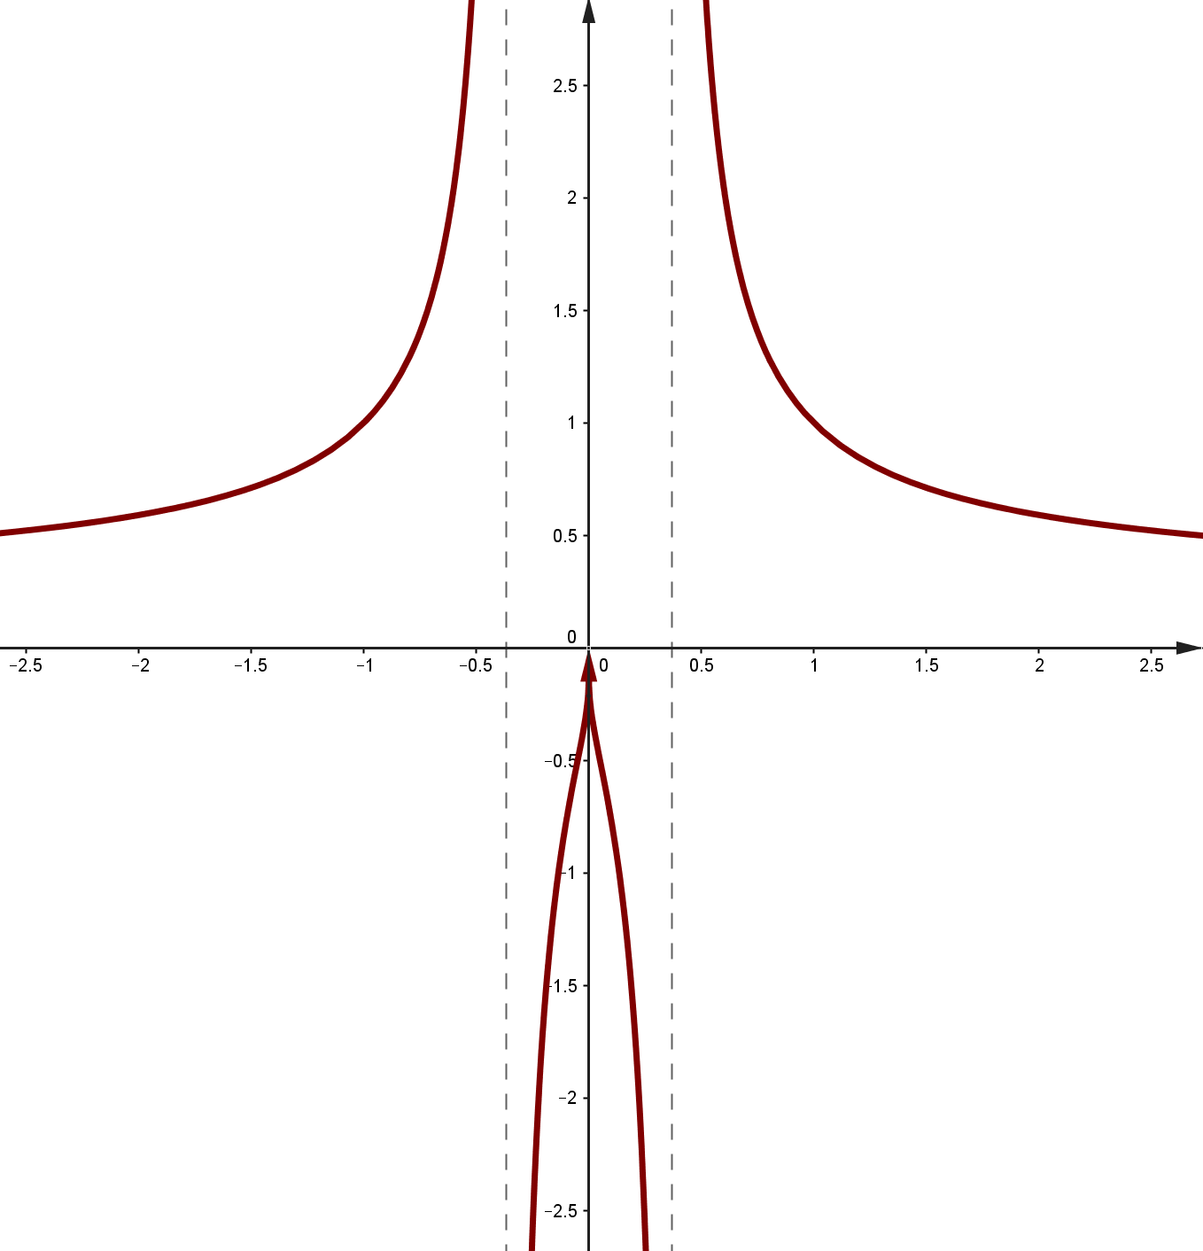

Slide 10
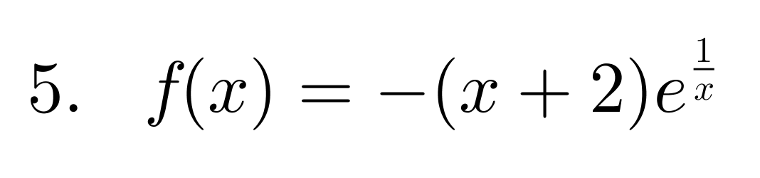

Slide 11
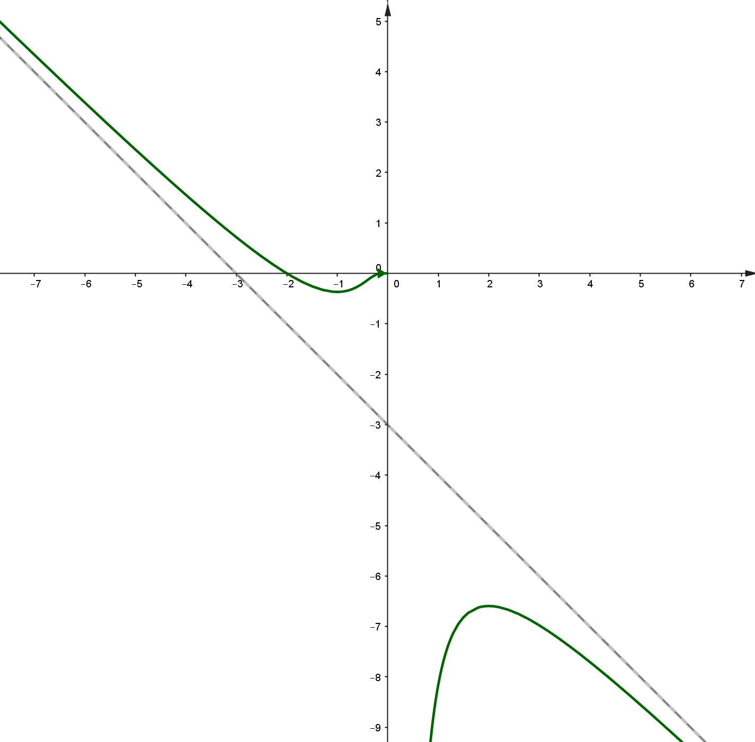

Slide 12
5/5 - Сјајан резултат!
4/5 - Врло добро!
3/5 - Добро!
2/5 - O.K (Ипак!)
1/5 - Обновити особине функција!

Slide 13
This powerpoint was kindly donated and adapted from www.worldofteaching.com
http://www.worldofteaching.com is home to over a thousand powerpoints submitted by teachers. This is a completely free site and requires no registration. Please visit and I hope it will help in your teaching.

